Slide 1
Why use GPUs instead of CPUs?

Slide 2
Short Answer:
They are faster.
Way faster.
The “fastest” and “largest” CPUs today have speeds around 4 GHs and about 128 cores, and costs about $5,000
An “average” GPU like the RTX 3080, has core speeds of 1.5 GHs and 5,888 cores, and costs about $1,000
Size not to scale
Cycles per second
8,832
512

Slide 3
Typical Data Science Workflows
Data Wrangling
Model training
Model validation
Extracting raw data
Organizing/structuring data
Exploratory analysis
Cleaning messy data
Feature Engineering
Model selection
Model tuning
Hyperparameter optimization
Model validation
Model testing (inference)

Slide 4
GPU Acceleration
GPU acceleration is commonly concentrated in the modeling portions.
Data Wrangling
Model training
Model validation

Slide 5
GPU Acceleration
GPU acceleration is commonly concentrated in the modeling portions.
Furthermore, that concentration tends to be in the Deep Learning and Neural Networks subfields.
This isn’t necessarily a bad thing; training a model in a matter of hours or days versus weeks is a huge improvement.
Still, it would be nice to be able to leverage the GPU for non-deep learning tasks….
Data Wrangling
Model training
Model validation
Non-Deep Learning
Non-Deep Learning
Deep Learning
Deep Learning

Slide 6



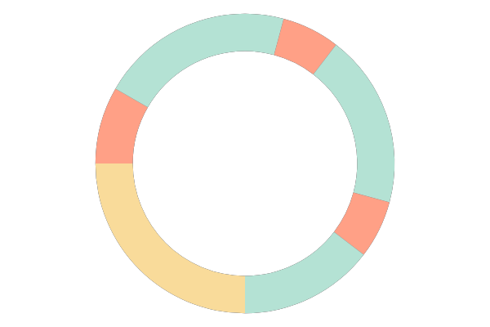
Typical CPU day
Another…
@*!# forgot to add a feature
Get a coffee
Restart ETL workflow
12
Start ETL workflow
Get a coffee
Switch to decaff
CPU POWERED WORKFLOW
Configure ETL workflow
9
3
Find unexpected null values stored as strings
dataset collection
Dataset downloads
overnight
analysis
6
ETL
train
Restart ETL workflow
inference
Stay late
https://developer.nvidia.com/blog/gpu-accelerated-analytics-rapids/

Slide 7
Points of frustration
Model train
Model val
Data Wrangling
~80%
~10%
~10%
At least 80% of my time was spend wrestling with the data!
Very little was left for model training and validation!
A huge bottleneck in productivity!

Slide 8








Points of frustration
CPU 1
CPU 1
CPU 2
CPU 3
CPU 3
CPU 5
CPU 4
CPU 7
CPU 5
CPU 9
CPU 6
CPU 11
Some languages, like R, will use all available CPU cores.
Python, by purposeful design, is limited to a single CPU.
Pandas has notoriously slow read, write, and aggregation speeds
I can get around this by using python’s multiprocessing module, which mimics multiprocessing, but it’s still an extra step.

Slide 9

A wonderful unified solution
The Rapids.ai is a suite of GPU accelerated libraries for python and include:
cuDF: mirroring Pandas
cuML: mirroring Scikit-learn
cuSignal: mirroring SciPy
cuXFilter: framework for visualization
cuGraph: mirroring NetworkX
and more!
In addition XGBoost, Dask, and Spark all have GPU implementations that utilize the Rapids engine.

Slide 10
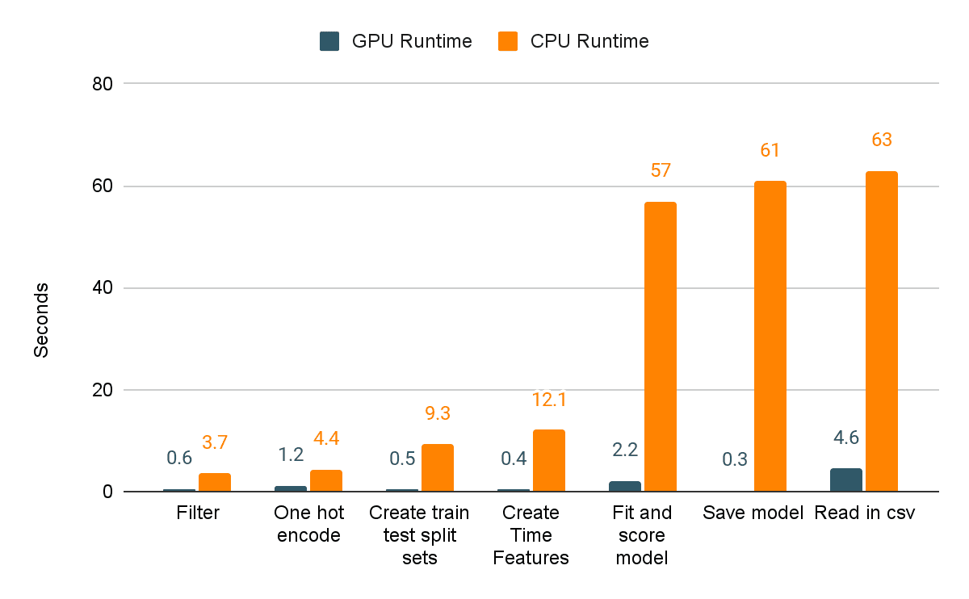
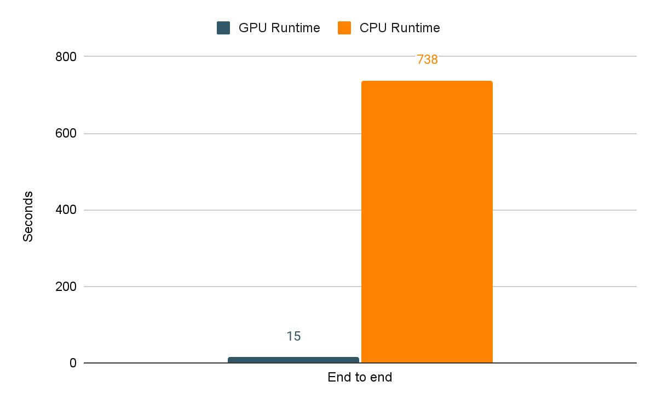
Comparing speeds: trip data for NYC taxis
I came across these on the internet…
Individual Tasks
Entire pipeline
…and had to test it out myself….
https://blog.cloudera.com/switching-from-cpus-to-gpus-for-nyc-taxi-fare-predictions-with-nvidia-rapids/

Slide 11
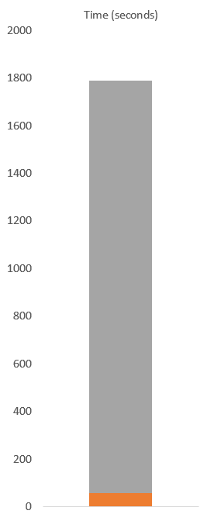
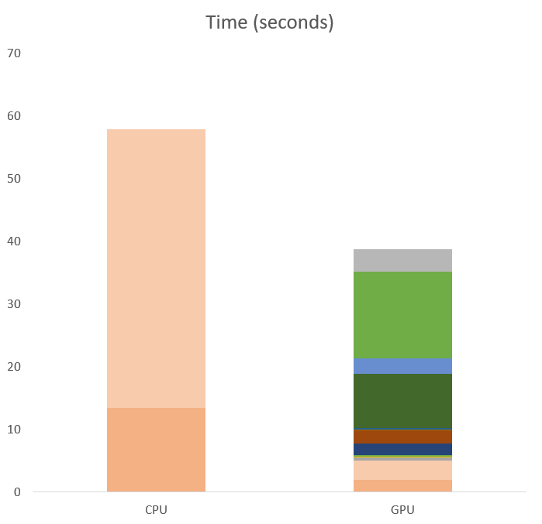
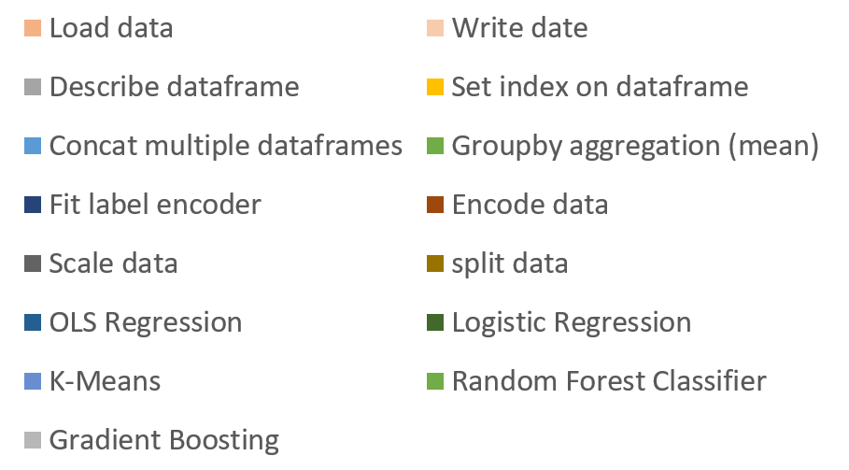
Benchmark: 20M rows & 10 columns
On CPU, in the time that it took to:
The GPU accomplished:
CPU
https://github.com/jonathancosme/GPU_vs_CPU

Slide 12
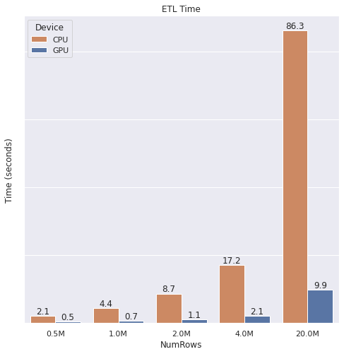
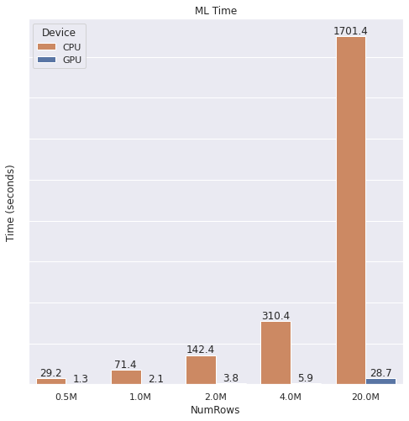

Benchmark: across different file sizes
For ETL, we see more than 85% reduction in time
For ML, we see a more than 98% reduction in time
End-to-end, we see a more than 95% reduction in time
The speed gain are astounding!
https://github.com/jonathancosme/GPU_vs_CPU

Slide 13
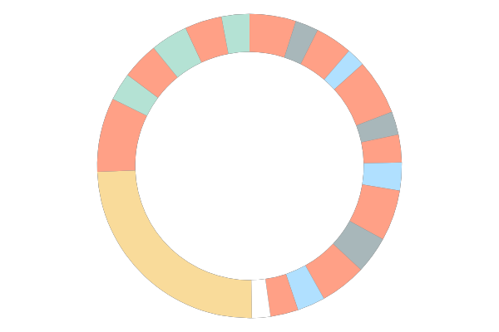
Typical GPU day
Find unexpected null values stored as strings
Restart ETL
Train model
Validate
Eh, forgot to add a feature
Test model
12
Start ETL
workflow
Get a coffee
Experiment with optimizations & repeat
GPU POWERED WORKFLOW
Configure ETL workflow
9
3
dataset collection
Dataset downloads
overnight
6
analysis
ETL
train
inference
Go home on time
https://developer.nvidia.com/blog/gpu-accelerated-analytics-rapids/

Slide 14
Comparing CPU vs GPU day
dataset collection
analysis
ETL
train
inference
Another…
@*!# forgot to add a feature
Find unexpected null values stored as strings
Restart ETL
Train model
Get a coffee
Validate
Restart ETL workflow
Eh, forgot to add a feature
Test model
12
12
Start ETL workflow
Get a coffee
Start ETL
workflow
Get a coffee
Experiment with optimizations & repeat
Switch to decaff
CPU POWERED WORKFLOW
GPU POWERED WORKFLOW
Configure ETL workflow
9
3
Configure ETL workflow
9
3
Find unexpected null values stored as strings
Dataset downloads
overnight
Dataset downloads
overnight
6
6
Restart ETL workflow
Stay late
Go home on time
https://developer.nvidia.com/blog/gpu-accelerated-analytics-rapids/

Slide 15
Speed gains with run.ai
Using run.ai’s state-of-the-art scheduler and fractional GPU capabilities, speed gains can be pushed to their maximum
ETL
train
inference
(Size not to scale)
Time
CPU
GPU
run.ai

Slide 16
FAQs

Slide 17
FAQs
All of my code is already in Pandas and Scikit-learn. Do I have to convert it all?
A valid concern!
cuDF was specifically build to mirror Pandas.
cuML was specifically build to mirror Scikit-Learn.
In nearly all cases, your Pandas/Scikit-Learn code is the same as the cuDF/cuML code!

Slide 18
FAQs
What if there’s something I must use pandas for?
No problem!
It's easy to convert back and forth between Pandas Dataframes and cuDF Dataframes!
# from cuDF to Pandas
df = df.to_pandas()
# your unique function
df = my_function(df)
# from Pandas to cuDF
df = cudf.from_pandas(df)

Slide 19
FAQs
What if my data is too large for GPU memory?
No problem!
The Rapids ecosystem includes Dask-GPU, which is designed to handle extremely large datasets, in a distributed way.
Best of all, Dask was originally designed to be a distributed extension of Pandas, so implementing it will be very easy if you are used to pandas!
If you are used to using Spark, Apache has also incorporated the Rapids.ai engine to leverage GPU for ETL pipelines.

Slide 20
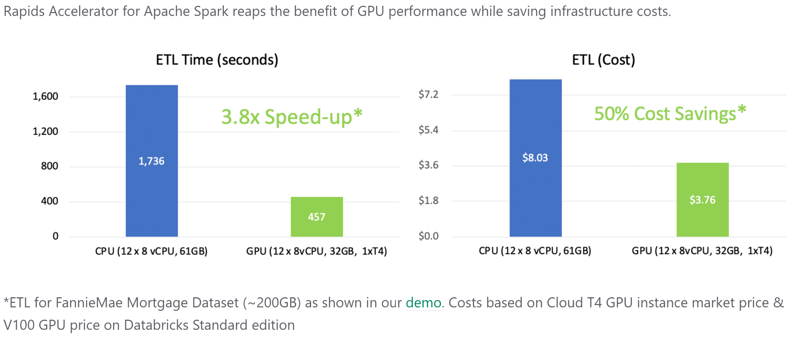
FAQs
GPU instances are expensive. Wouldn't it be cheaper to run a large CPU cluster rather than a GPU?
Actually, because a GPU can process data so much more quickly, the net cost of running a workflow on a GPU vs a large CPU cluster is actually less!
https://nvidia.github.io/spark-rapids/

Slide 21
Use GPUs!

